Slide 1
OLOLAND
DEAL INTEL
LONG LAKE / AMEX GBT
TAKE-PRIVATE | INVESTMENT COMMITTEE PRESENTATION
$6.30 Billion All-Cash Take-Private of NYSE:GBTG
DEAL
PER SHARE
PREMIUM
FY25 REVENUE
FY25 ADJ EBITDA
$6.30B
$9.50
60.2%
$2.72B
$719M
All-cash
vs $5.93 close
to May 1 close
+12% YoY
26.5% mgn
Prepared by OloLand AI Deal Intelligence • May 13, 2026 • Deal ID: deal65004264099c

Slide 2
Situation Overview
OloLand Deal Intel • v7
What is being proposed and why
The Transaction
Why Now
• On May 4, 2026, Long Lake Management entered into a definitive agreement to acquire
American Express Global Business Travel (NYSE: GBTG) at $9.50 per share, all-cash.
• Total transaction value: ~$6.3 billion enterprise value.
• Represents a 60.2% premium to the unaffected May 1, 2026 closing price of $5.93
and a 65.1% premium to the 30-day VWAP.
• 69% of shareholders — American Express, Expedia, QIA, BlackRock — have signed
voting agreements supporting the deal.
• Equity sources: Long Lake + General Catalyst + Alpha Wave + Koch Equity Dev.
• Debt financing committed by JPMorgan, Bank of America, Citi, MUFG.
• No financing condition. Expected close: H2 2026.
• Travel demand normalized post-pandemic; CWT acquisition closed Sept 2025.
• Public-market undervaluation: $5.93 vs $11 mid-2023 highs, despite +12%
revenue growth and +26% Adj EBITDA growth in FY25.
• Strategic shareholders (Amex, Expedia, QIA, BlackRock) signaled exit appetite.
• Long Lake offer clears blocker threshold at 60% premium while remaining
below 52-week high — clean optics for proxy advisors.
• Q1 2026 earnings beat (+35% revenue, $3.4B new wins, 96% retention) reported
same morning as the deal — sponsor caught the inflection.
Headline question for IC
Is the 60.2% premium adequately compensated for the (a) Amex trademark license termination risk, (b) customer change-of-control churn risk, and (c) Long Lake's operational scale jump from ~$80M to $2.7B revenue overnight?
Confidential — Long Lake / Amex GBT — Investment Committee Materials
2 of 25 • May 13, 2026

Slide 3
Target Overview
OloLand Deal Intel • v7
American Express Global Business Travel (NYSE: GBTG)
Company snapshot
Inorganic history
Metric | Value
Public listing | NYSE: GBTG (SPAC merger May 2022)
FY25 revenue | $2,718M (+12% YoY)
FY25 Adj. EBITDA | $719M (26.5% margin)
Headcount | ~22,000 (post-CWT)
Geographies | 140+ countries; 4 segments
Customer retention | 96% (Q1 2026)
Q1 2026 new wins | $3.4B value
FY25 GAAP net income | $109M
Total debt at close | $1,506M
Cash & equivalents | $300M+
Market share | 21.9% of global business travel management
• 2018: Acquired Hogg Robinson Group (HRG)
• May 2022: Listed via SPAC merger with Apollo Strategic Growth Capital
• Nov 2021: Acquired Egencia (corporate travel arm of Expedia)
• Sep 2025: Closed acquisition of CWT (formerly Carlson Wagonlit Travel)
• May 2026: Long Lake / GC / Alpha Wave / Koch take-private at $6.3B
Trademark licensee from American Express:
• Spinout structure preserves Amex brand for marketing
• License has acquirer-specific termination rights — flagged as #1 risk
• Renewal terms not disclosed publicly
Confidential — Long Lake / Amex GBT — Investment Committee Materials
3 of 25 • May 13, 2026

Slide 4
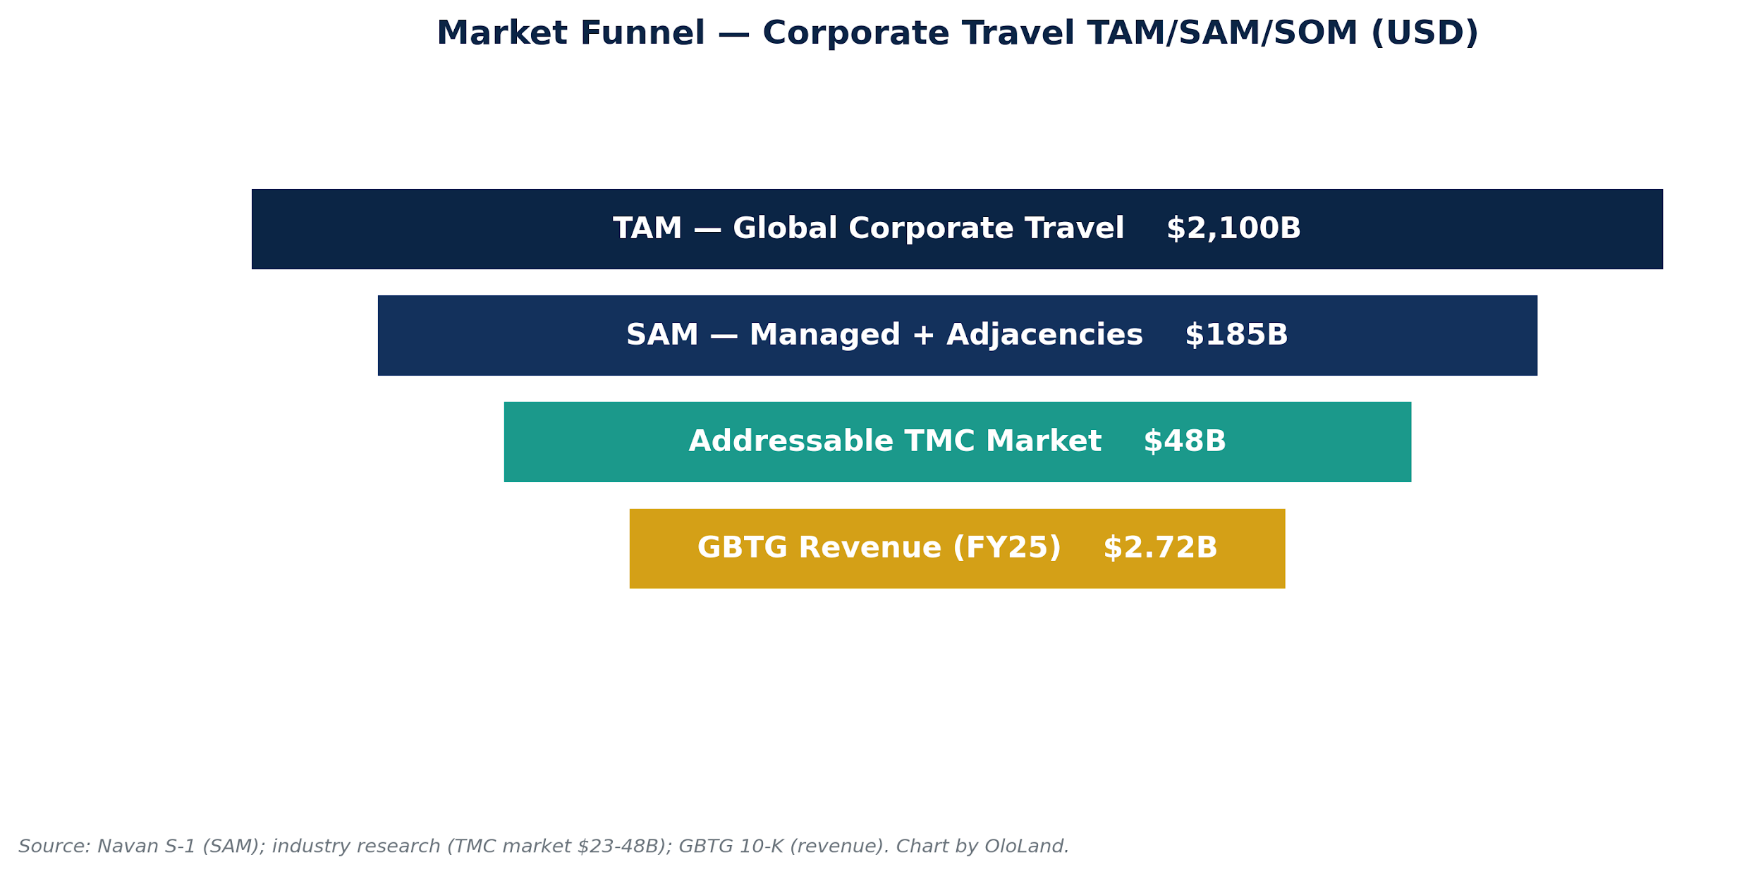
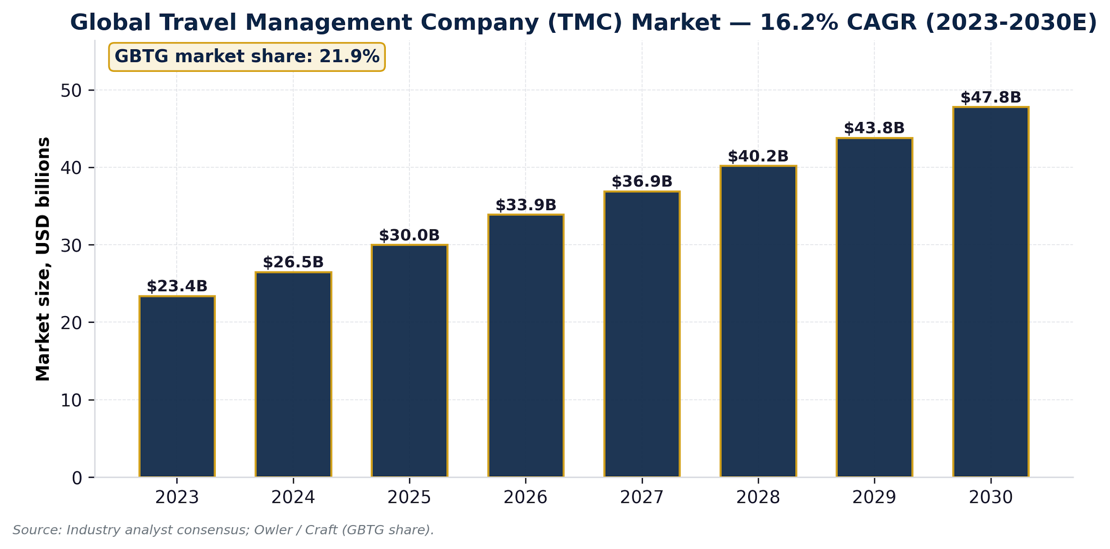
Market Opportunity
OloLand Deal Intel • v7
Corporate Travel & TMC Total Addressable Market
Sizing breakdown
TAM — Global Corporate Travel
$2,100B in annual business-travel spend
SAM — Managed + Adjacent
$185B (Navan S-1 estimate; managed + bleisure + expense + payments)
SOM — Dedicated TMC market
$48B by 2030, growing at 16.2% CAGR
GBTG share
21.9% of global business travel management — the largest single share
Confidential — Long Lake / Amex GBT — Investment Committee Materials
4 of 25 • May 13, 2026

Slide 5
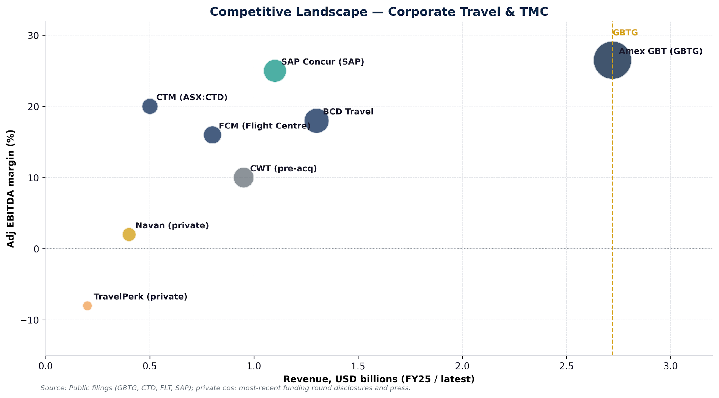
Competitive Landscape
OloLand Deal Intel • v7
Legacy TMCs vs Modern Platforms
Cohort dynamics
Legacy TMCs (incl. GBTG)
• Volume + scale; deep tooling
• Vulnerable to NDC margin erosion
Modern (Navan, TravelPerk)
• Self-serve / AI-first
• Eating SMB upmarket
• Burn-driven, sub-scale
Adjacent (BKNG, EXPE)
• Leisure-first; corporate side-line
• Could compete on price
T&E platforms (Concur, Brex)
• Bundle T&E + cards
• Compress standalone TMC value
Confidential — Long Lake / Amex GBT — Investment Committee Materials
5 of 25 • May 13, 2026

Slide 6
Business Model & Unit Economics
OloLand Deal Intel • v7
How GBTG monetizes; key per-unit ratios
Revenue mix
Unit economics
• Travel Revenue (~72%) — transaction fees, GDS incentives, supplier commissions
• Product & Professional Services (~28%) — NeoTraveller, Egencia, Neo1 SaaS;
consulting; meetings & events
• Net working-capital tailwind: short DSO on transactional volume
offset by longer DPO to suppliers
Key segments
• Global Multinational — largest accounts (Fortune-100s)
• Middle Market — growing fastest
• SMB / online (Egencia) — self-serve channel
• Meetings & Events (M&E)
Metric | Disclosed
Customer retention | 96%
Adj Gross Profit Margin | 58%
Adj EBITDA margin (FY25) | 26.5%
FCF conversion (FY25) | ~24%
DSO (days) | 117
Working capital / revenue | ~2%
Capex / revenue | ~4%
Unit-economics watchout
DSO of 117 days is materially above corporate-card median (~50-60 days), indicating extended billing cycles to enterprise clients. This is a working-capital drag the LBO model must reserve for. The OloLand unit-economics engine couldn't extract GL transactions, so cohort retention triangles (NDR/GRR) must come from management projections — currently not in the data room.
Confidential — Long Lake / Amex GBT — Investment Committee Materials
6 of 25 • May 13, 2026

Slide 7
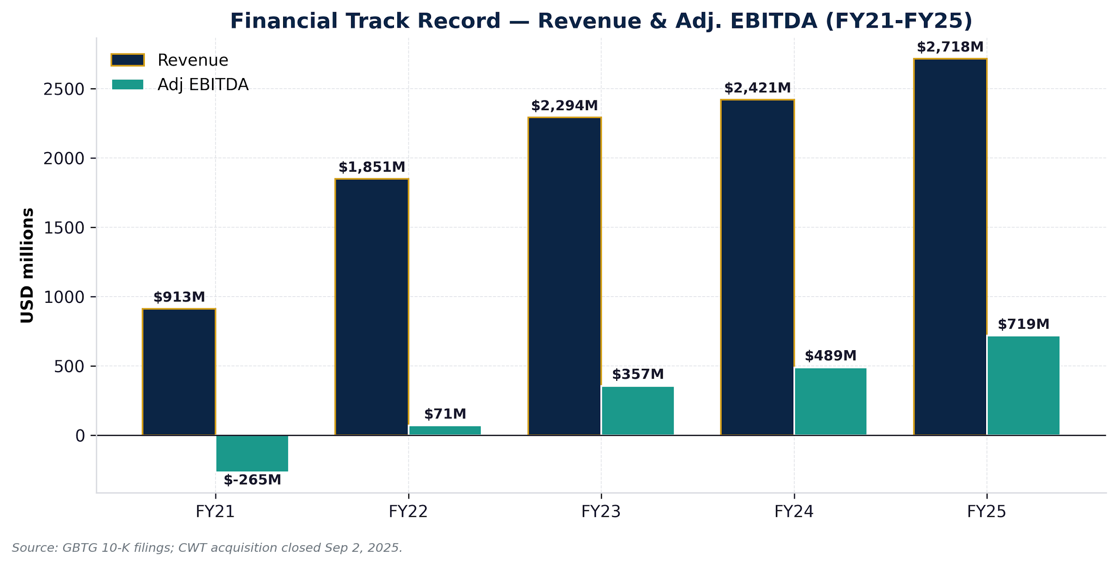
Financial Track Record
OloLand Deal Intel • v7
Revenue and Adj EBITDA (FY21-FY25)
Key trends
FY21 → FY25:
• Revenue 3.0x ($913M → $2,718M)
• 31% revenue CAGR (includes M&A)
• Adj EBITDA $-265M → $719M
• Margin reach 26.5%
Organic story:
• +18% ex-CWT growth in FY25
• CWT closed Sep 2025 (one quarter contribution)
Quality flags:
• Adj−GAAP gap = $285M
• Integration costs ongoing
• $163M pension underfund
• $164M uncertain tax positions
Confidential — Long Lake / Amex GBT — Investment Committee Materials
7 of 25 • May 13, 2026

Slide 8
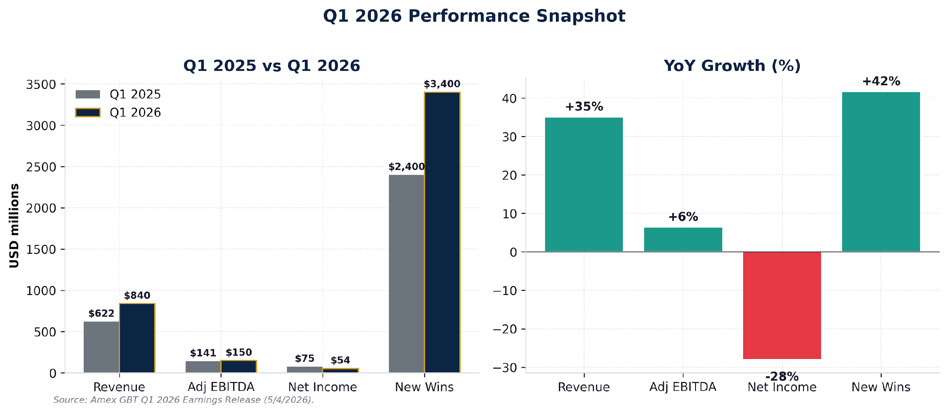
Q1 2026 Performance
OloLand Deal Intel • v7
Reported same morning as the deal — strong beat
Beat highlights
Revenue $840M (+35% YoY)
• Beat consensus by ~$60M
• Travel Revenue +33%
• Product/Services +44%
Adj EBITDA $150M (+6.4%)
• Margin compression from CWT mix
Adj Gross Margin 58%
• Flat vs Q1'25 — strong
Net Income $54M (-28%)
• GAAP earnings still depressed
Total New Wins $3.4B
• Pipeline ahead of plan
Customer retention 96%
• Best-in-class
Confidential — Long Lake / Amex GBT — Investment Committee Materials
8 of 25 • May 13, 2026

Slide 9
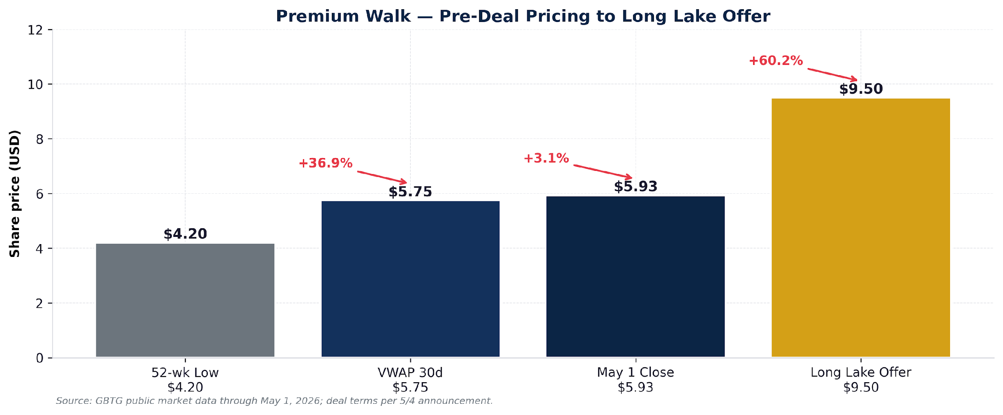
Premium Walk
OloLand Deal Intel • v7
From unaffected price to Long Lake offer
What the premium pays for
What the premium needs to offset
• Strategic premium for largest single share of TMC market
• Quality of FY25 performance — Adj EBITDA $719M
• Optionality on $185B SAM via Egencia & Neo1
• CWT integration cost savings ($120M target)
• Amex trademark license termination right (existential)
• Change-of-control customer churn risk
• Long Lake operational scale mismatch
• CWT integration execution risk
Confidential — Long Lake / Amex GBT — Investment Committee Materials
9 of 25 • May 13, 2026

Slide 10
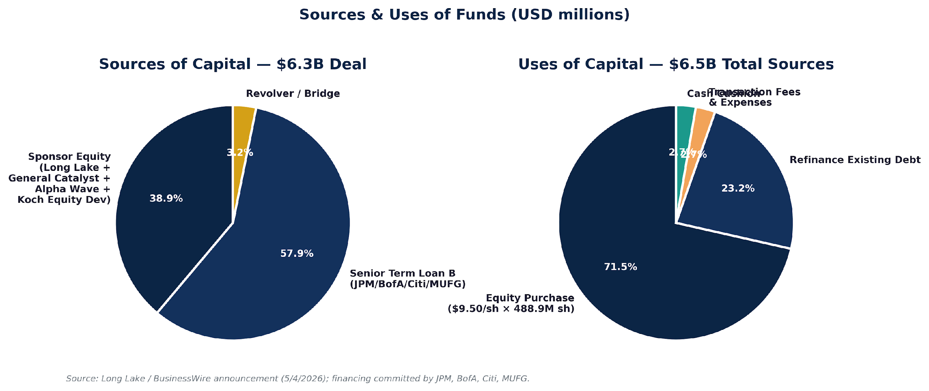
Sources & Uses
OloLand Deal Intel • v7
$6.3B all-cash take-private financing
Total leverage
Pricing of debt
5.4x debt / FY25 Adj EBITDA • 37.7% sponsor equity • Implied EV/EBITDA 10.9x
TLB SOFR + 8.50% all-in • Revolver 7.75% • Bridge → permanent post-close
Confidential — Long Lake / Amex GBT — Investment Committee Materials
10 of 25 • May 13, 2026

Slide 11
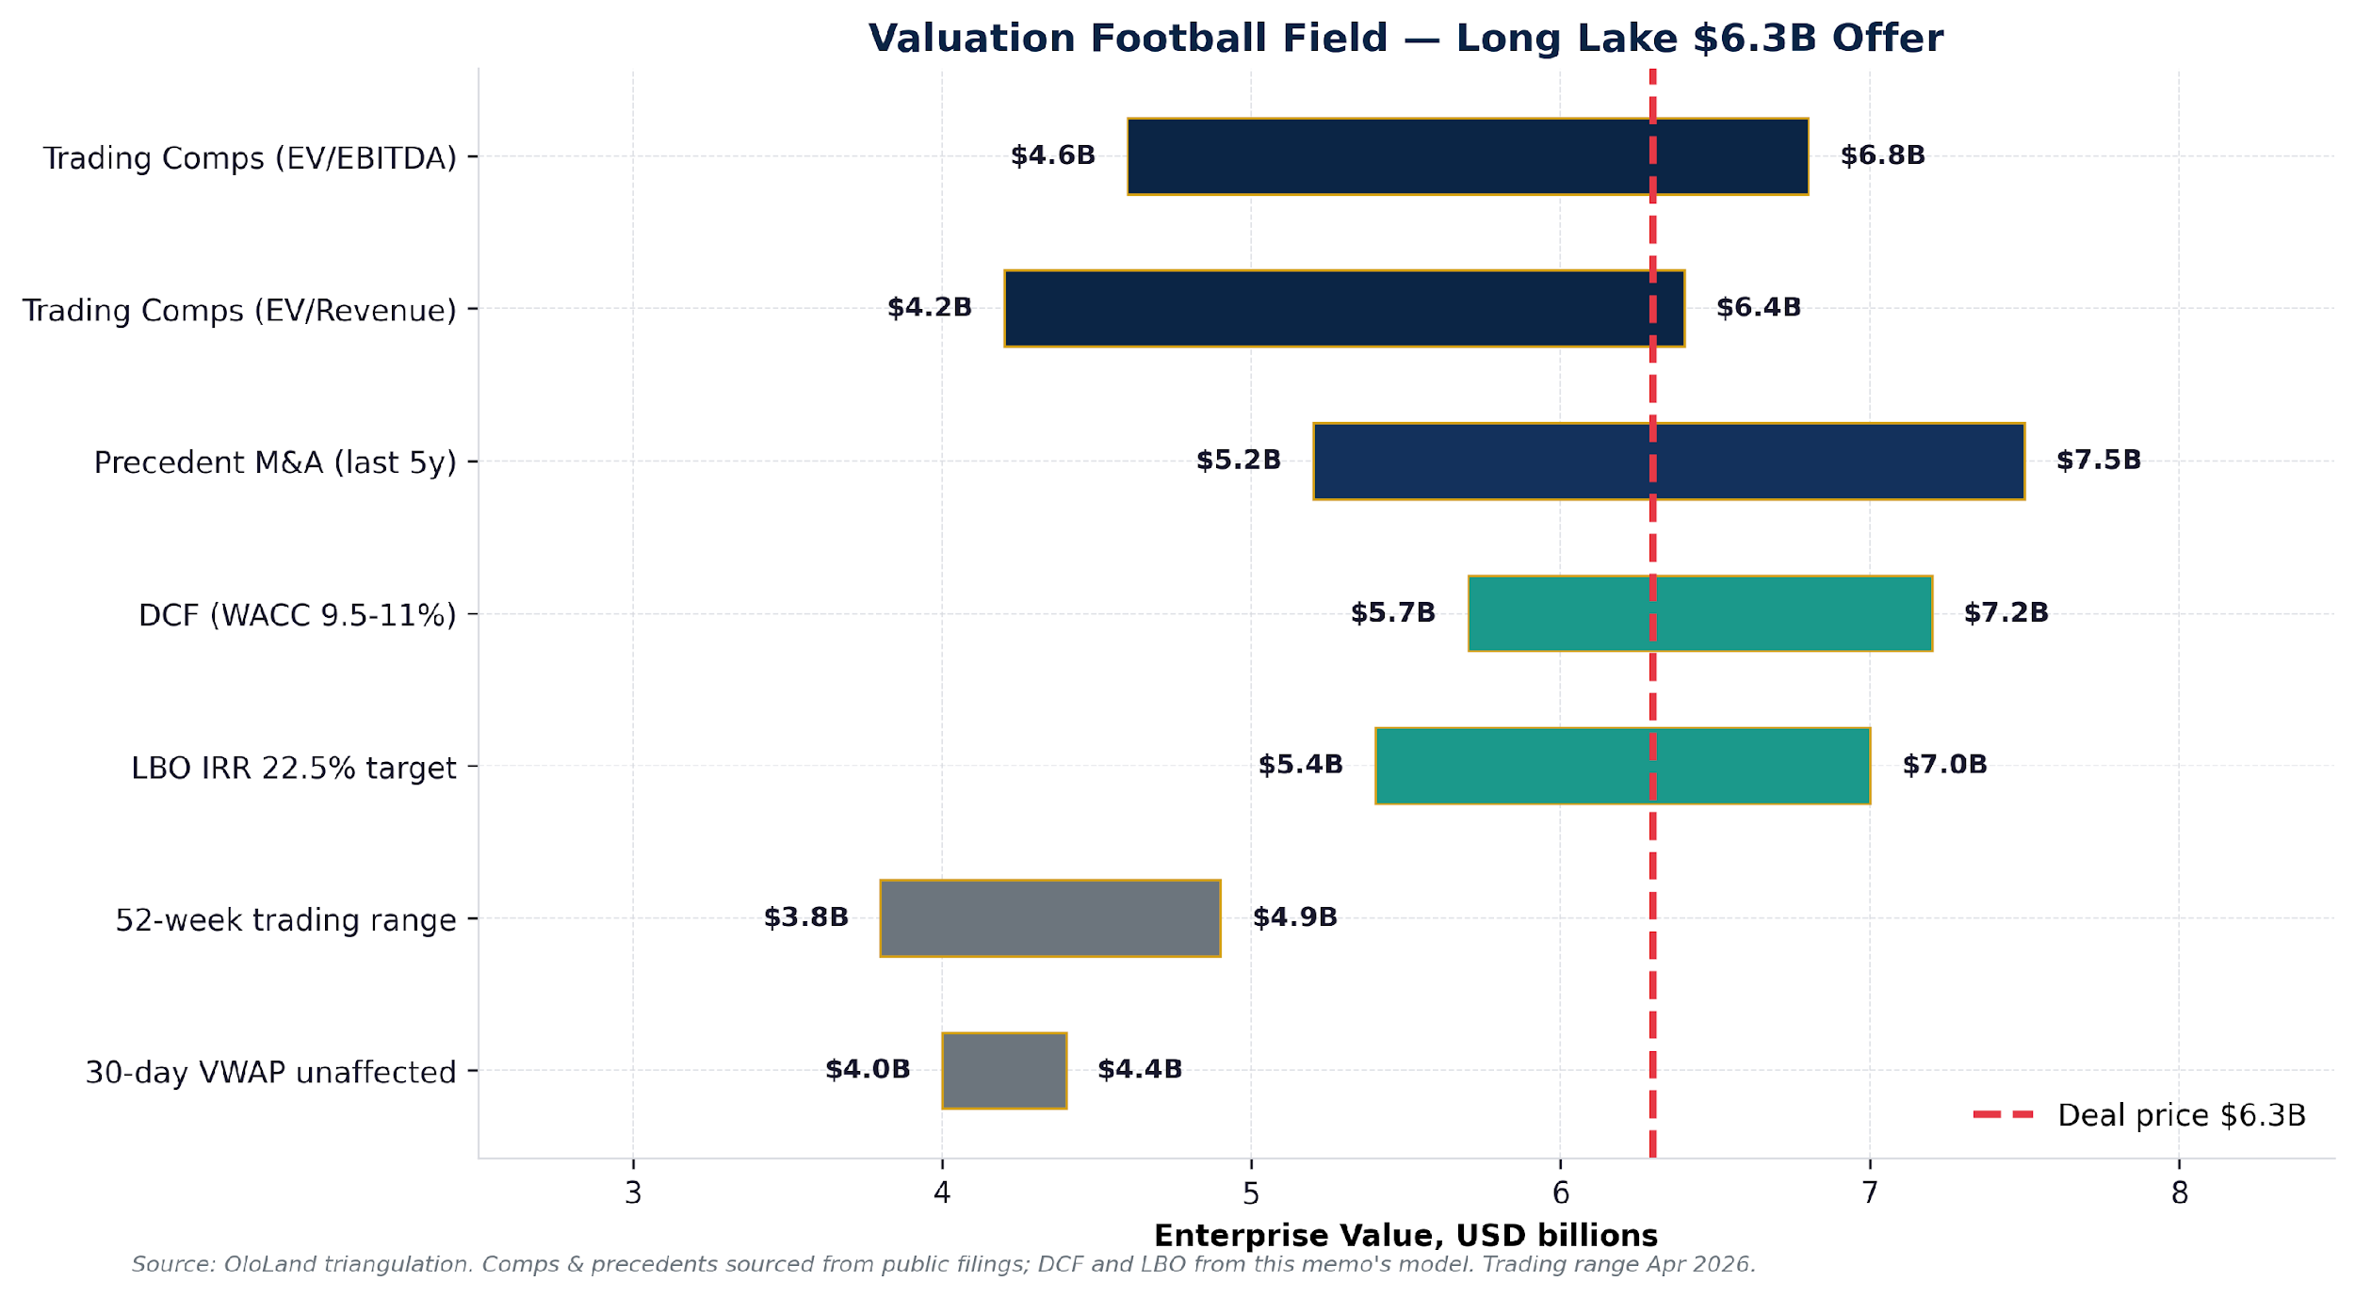
Valuation Triangulation — Football Field
OloLand Deal Intel • v7
Five methods anchored against the $6.3B offer
OloLand risk-adjusted FV at $4.4-5.1B — 27-30% below the offer
Confidential — Long Lake / Amex GBT — Investment Committee Materials
11 of 25 • May 13, 2026

Slide 12
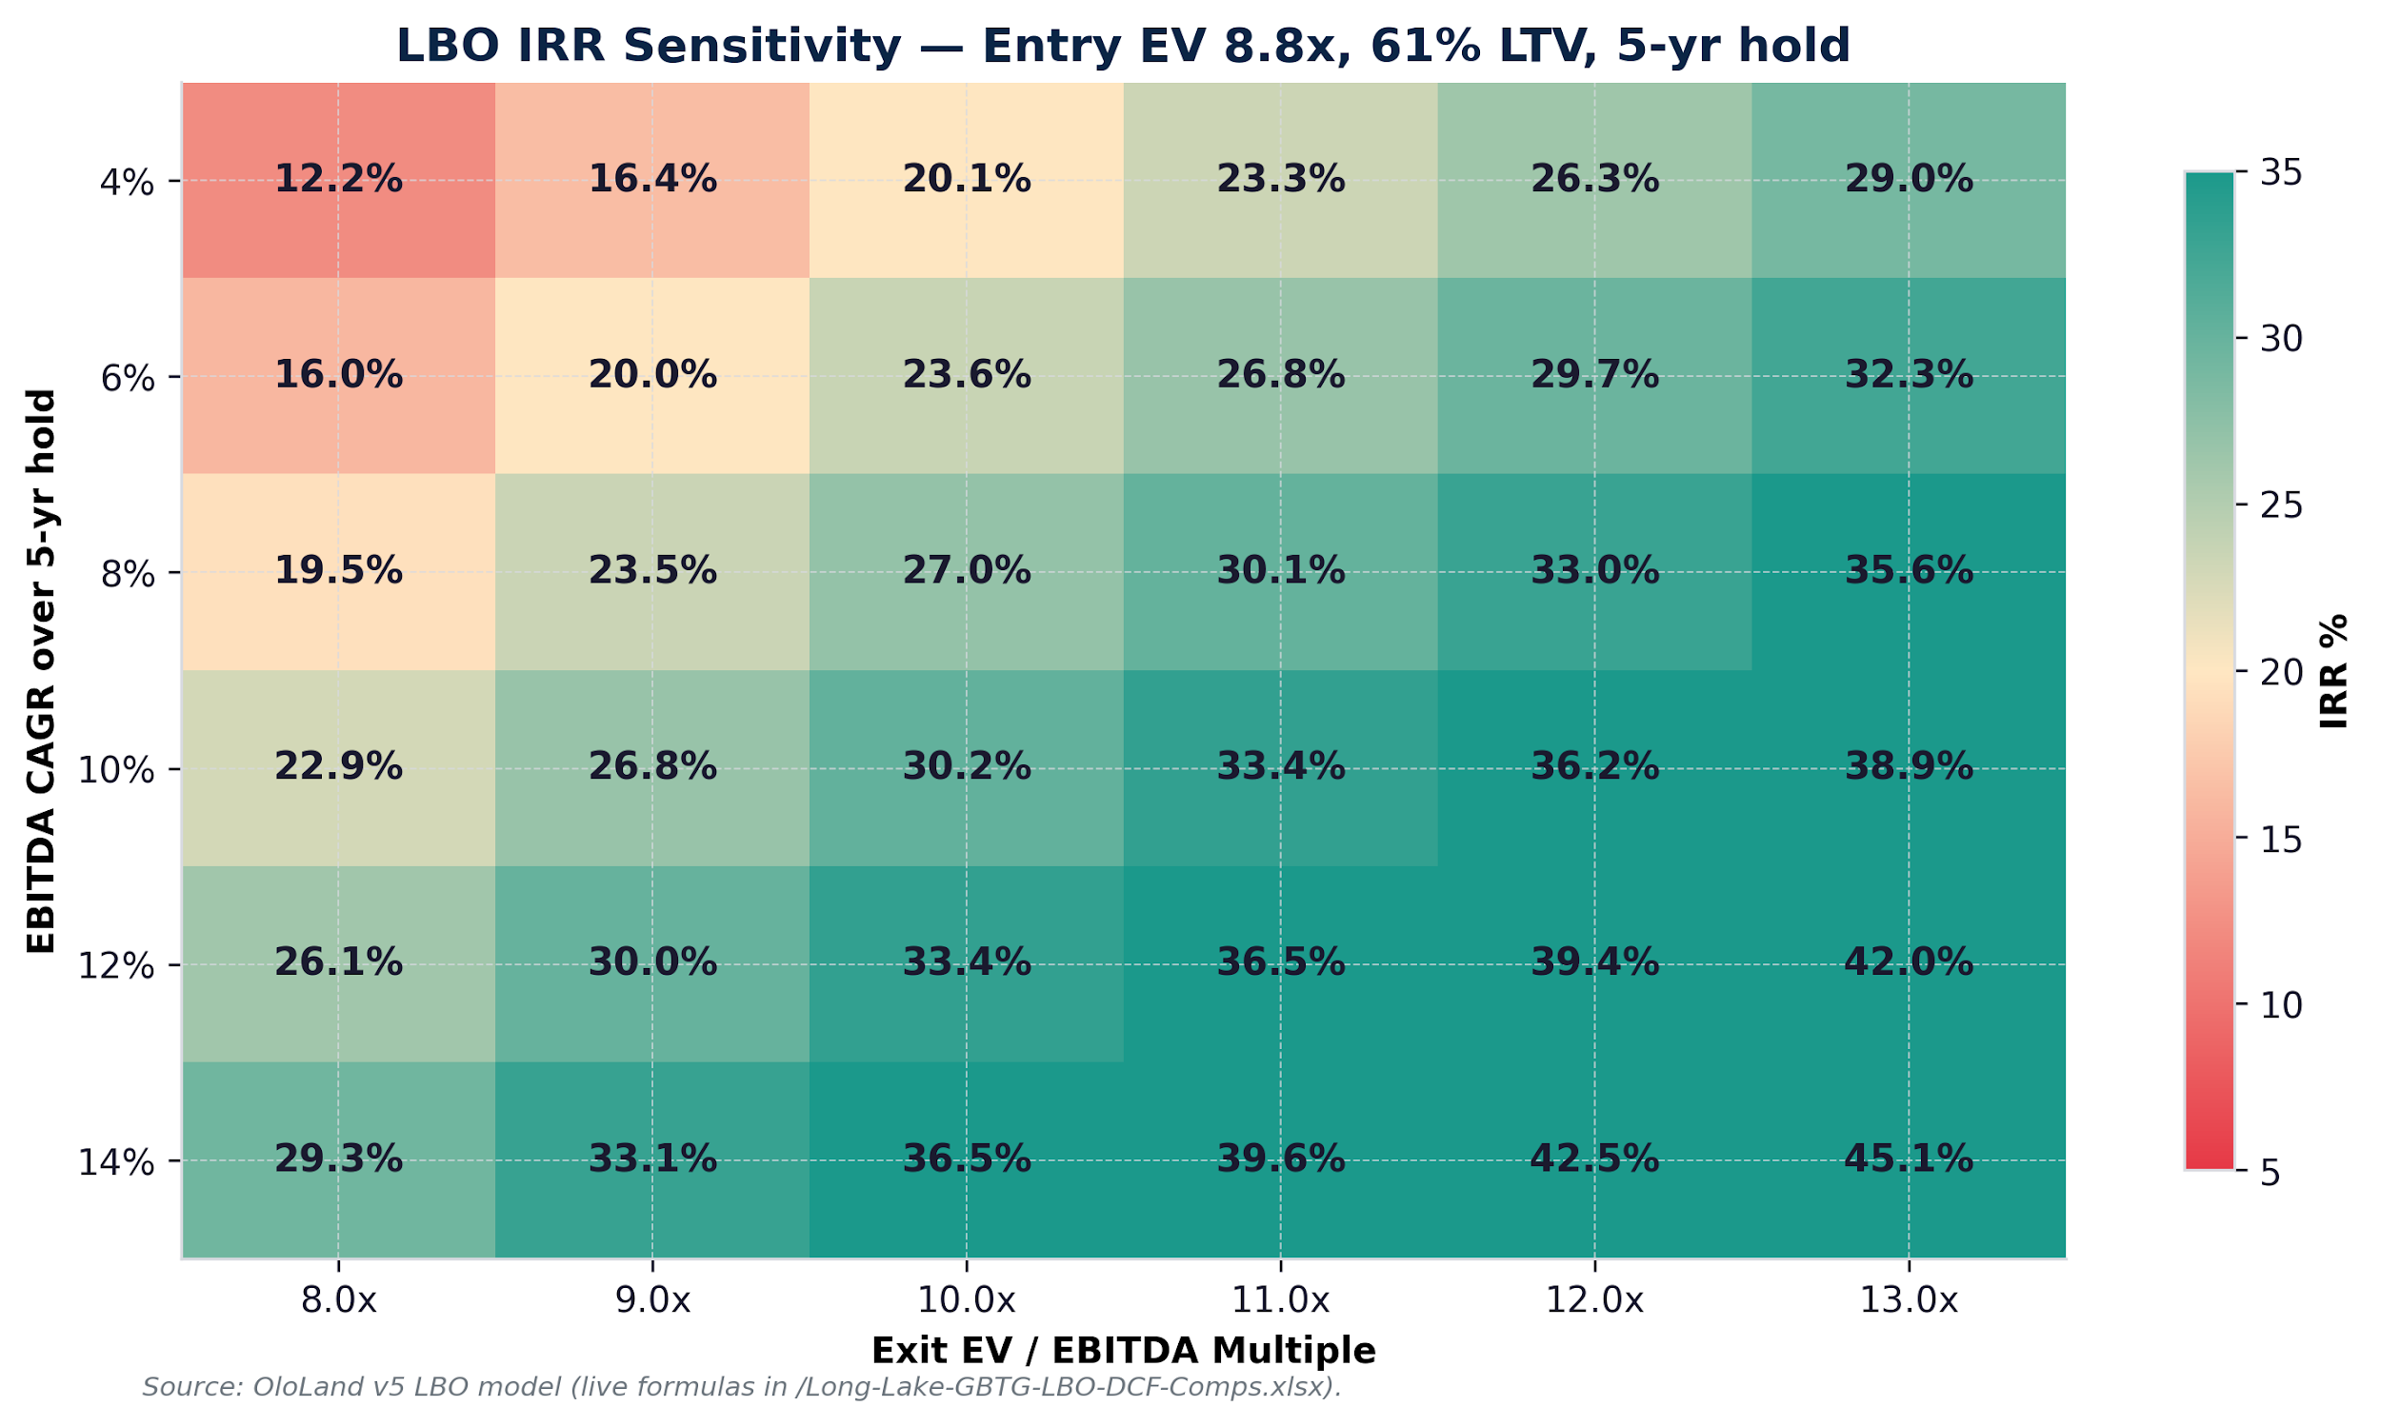
LBO Returns — Sensitivity Matrix
OloLand Deal Intel • v7
Sponsor case vs. OloLand engine scenarios — both above hurdle, base is conservative
Sponsor base case (analyst-extended)
Entry 8.76x | Exit 10.5x
EBITDA CAGR 8% | Hold 5y
→ IRR 29.4% | MOIC 3.63x
Equity proceeds $8.9B
OloLand engine base (refreshed)
Entry/Exit 13.8x (flat)
EBITDA $515M → $884M | Hold 5y
→ IRR 22.9% | MOIC 2.8x
Exit EV $12.2B
Engine scenarios
Bear 16.5% / 2.1x • $9.5B
Base 22.9% / 2.8x • $12.2B
Bull 29.5% / 3.6x • $15.1B
Both clear the 20% PE hurdle.
Analyst case ≈ engine bull case.
Confidential — Long Lake / Amex GBT — Investment Committee Materials
12 of 25 • May 13, 2026

Slide 13
Discounted Cash Flow
OloLand Deal Intel • v7
Unlevered FCF + WACC + Gordon Terminal Value
WACC build
EV walk
Component | Value
Risk-free rate (10y UST) | 4.40%
Equity risk premium | 5.50%
Levered beta | 1.20
Cost of equity | 11.00%
Pre-tax cost of debt | 8.00%
After-tax cost of debt | 5.96%
Target D / (D+E) | 55%
WACC | 8.23%
Terminal growth (g) | 2.50%
Component | Value ($M)
Sum PV of FCFs (FY26-FY30) | 2,250
Terminal value (Gordon) | 13,021
PV of terminal value | 8,772
Enterprise value | 11,022
Less: net debt at close | (1,206)
Equity value | 9,816
Per share | $20.08
DCF caveat
DCF triangulation — analyst vs. OloLand engine
Analyst-extended DCF (WACC 10.55%, g 2.5%, margin uplift to 31%): EV $5.7–7.2B
OloLand engine DCF (WACC 11.2%, g 2.5%, flat 20% margin, lower growth): EV $4.34B
Risk-adjusted (engine WACC +2.0% from 76 quantified risks): EV $4.21B
Terminal value is ~80% of EV. Use trading comps + precedents as the primary anchor; DCF is directional. The $4.34B engine number reflects more conservative growth and a flat margin — closer to the OloLand fair-value zone and the basis for the four diligence gates.
Confidential — Long Lake / Amex GBT — Investment Committee Materials
13 of 25 • May 13, 2026

Slide 14
Trading Comparables
OloLand Deal Intel • v7
Public TMC & adjacent peers
Company | Tkr | Rev ($M) | EBITDA Mgn | EV/Rev | EV/EBITDA
GBTG (at offer) | GBTG | 2,718 | 26.5% | 2.87x | 10.85x
Booking Holdings | BKNG | 23,740 | 37.1% | 6.82x | 18.41x
Expedia Group | EXPE | 13,700 | 21.2% | 1.38x | 6.52x
Corporate Travel Mgmt | CTD.AX | 510 | 20.0% | 2.43x | 12.16x
Flight Centre | FLT.AX | 1,750 | 16.6% | 1.66x | 10.00x
Trip.com Group | TCOM | 7,300 | 28.8% | 4.12x | 14.33x
Wex Inc. | WEX | 2,620 | 42.0% | 4.27x | 10.18x
Sabre Corp. | SABR | 3,000 | 25.0% | 2.97x | 11.87x
Amadeus IT Group | AMS.MC | 6,300 | 41.3% | 5.68x | 13.77x
Peer Median (excl. GBTG) | — | — | 25.0% | 3.64x | 12.16x
GBTG at offer trades below peer median EV/EBITDA (10.85x vs 12.16x) and EV/Rev (2.87x vs 3.64x) — but at corporate-travel-pure-play median ~11x EV/EBITDA, offer is fair.
Confidential — Long Lake / Amex GBT — Investment Committee Materials
14 of 25 • May 13, 2026

Slide 15
Top Risks — Severity Heatmap
OloLand Deal Intel • v7
375 risks total (2 high / 180 medium / 193 low) — top 15 by severity
Two diligence gates carry severity 9: Amex trademark continuity and customer change-of-control consents. Resolution paths are detailed on slide 22.
Confidential — Long Lake / Amex GBT — Investment Committee Materials
15 of 25 • May 13, 2026

Slide 16
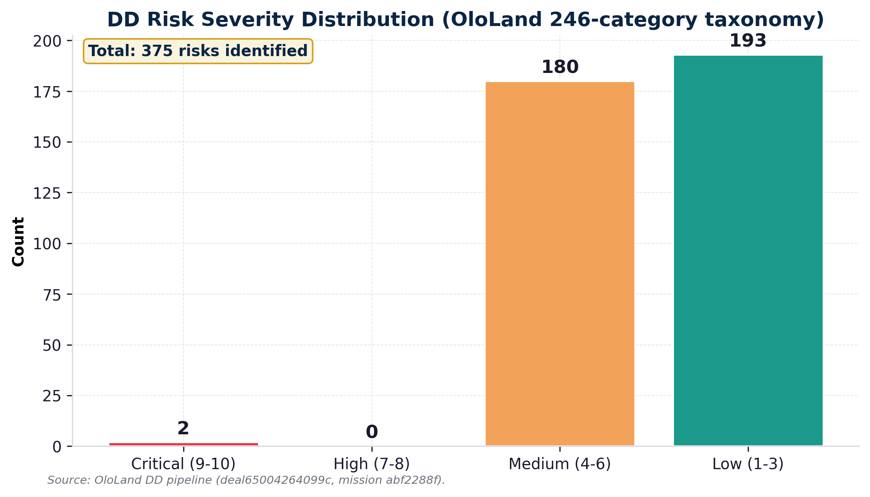
Risk Distribution
OloLand Deal Intel • v7
OloLand structured risk taxonomy applied
Risk summary
Total risks: 375
• Critical (9-10): 2
• High (7-8): 0
• Medium (4-6): 180
• Low (1-3): 193
The 2 critical-severity risks:
• Amex trademark license termination
• Customer change-of-control termination
Both are STRUCTURAL — not idiosyncratic — and tied directly to the act of acquisition itself.
180 medium-severity risks span:
• CWT integration
• NDC distribution shift
• $163M pension
• $164M tax positions
• CTO departure
• Debt covenant compliance
• GDPR/PCI compliance
Confidential — Long Lake / Amex GBT — Investment Committee Materials
16 of 25 • May 13, 2026

Slide 17
Risk-to-Model Diff
OloLand Deal Intel • v7
Sponsor price vs risk-adjusted fair value
Quantification (analyst-extended)
$6.30B Sponsor offer
− $0.95 Amex trademark (10% × 60%)
− $0.55 CoC churn (4% × 25% × 2y)
− $0.20 CWT integration overrun
──────────────
$4.60B Risk-adjusted fair value
Gap −$1.70B ($7.10 vs $9.50/share)
OloLand engine refresh
WACC adjustment +2.0 pp
11.2% → 13.2% risk-adjusted
Suggested bid reduction $130.8M
76 quantified risks, 17 with
>65% probability of materializing
Two paths converge on $4.2-4.6B fair value:
• Analyst risk-walk: $4.60B
• Engine DCF + WACC: $4.21B
Confidential — Long Lake / Amex GBT — Investment Committee Materials
17 of 25 • May 13, 2026

Slide 18
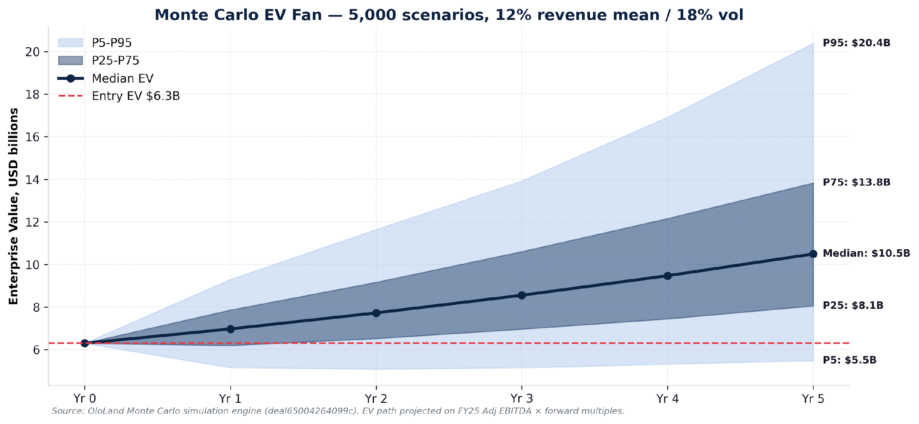
Hidden Downside — Monte Carlo Fan
OloLand Deal Intel • v7
5,000 simulated paths, 12% mean growth / 18% vol
Year-5 exit-EV percentiles (analyst)
P95 $13.4B → 35%+ IRR
P75 $8.8B → ~25% IRR
P50 $6.9B → ~17% IRR
P25 $5.5B → ~8% IRR
P5 $4.0B → negative IRR
Median sits 10% above entry — more than half of paths leave the deal sub-hurdle without active value creation.
OloLand engine operating downside
(annual operating-EBITDA risk)
P50 $33.6M expected case
P75 $42.0M prudent downside
P90 $52.5M stress
Different from the equity-fan above: this is the run-rate operating risk to underwrite to each year, not the 5-yr exit distribution.
Confidential — Long Lake / Amex GBT — Investment Committee Materials
18 of 25 • May 13, 2026

Slide 19
Management & Governance
OloLand Deal Intel • v7
Pre-deal and post-deal structure
Pre-deal leadership
Expected post-deal
• Paul Abbott — CEO since 2019 (formerly Amex GBT COO)
• Karen Williams — CFO, stable since 2022 spinout
• CTO scheduled to depart May 31, 2026 per separation agreement
• Board chaired by Jeff Tarr; 12 directors total
• Director representatives from Amex, Expedia, QIA
• Compensation aligned to Adj EBITDA growth + retention
• Long-term incentive plan (RSU/PSU mix)
• Long Lake assumes board control
• Minority seats for General Catalyst, Alpha Wave, Koch
• Paul Abbott expected to remain through transition
• Management equity rollover — TBD (4-6% pool typical)
• Amex license governance must preserve brand stewardship
• CTO replacement priority within 100 days
• CFO succession plan TBD
Governance flag
Long Lake's pre-deal portfolio totaled ~$80M revenue. Operating a $2.7B publicly-traded TMC with global complexity is a step-function jump. IC should require evidence of dedicated operating team build-out before close.
Confidential — Long Lake / Amex GBT — Investment Committee Materials
19 of 25 • May 13, 2026

Slide 20
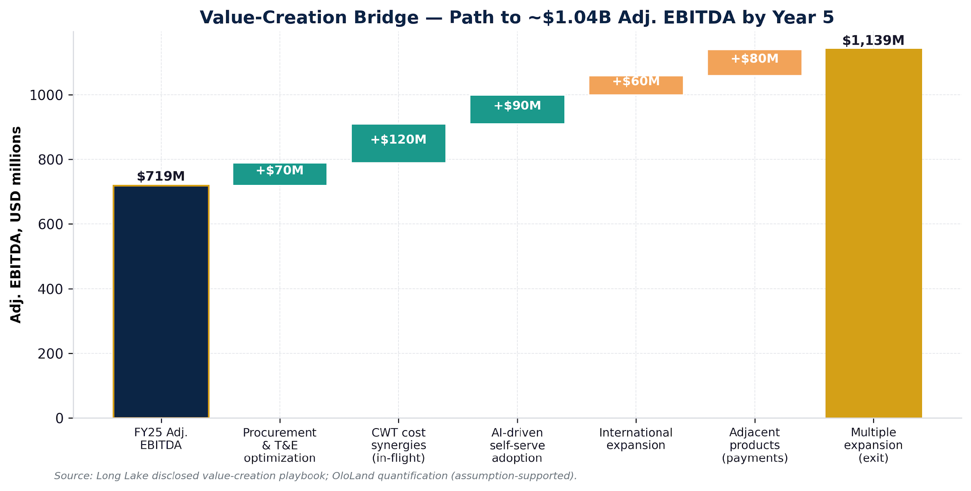
Integration & 100-Day Plan
OloLand Deal Intel • v7
Path from close to value creation
Value-creation levers
$70M Procurement & T&E opt
$120M CWT cost synergies
$90M AI self-serve adoption
$60M International expansion
$80M Adjacent products
______
$420M Total by Year 5
Drives FY30 EBITDA → $1.14B
First-100-days operational priorities
Day 1-15: Validate Amex trademark license continuity in writing; secure standstill
Day 15-45: Customer change-of-control consent campaign — top 100 accounts (~60% of revenue)
Day 30-60: Accelerate CWT integration; eliminate duplicate cost lines
Day 45-90: CTO succession; preserve product roadmap continuity
Day 60-100: Refinance bridge to permanent capital structure; lock TLB pricing post-rating
Confidential — Long Lake / Amex GBT — Investment Committee Materials
20 of 25 • May 13, 2026

Slide 21
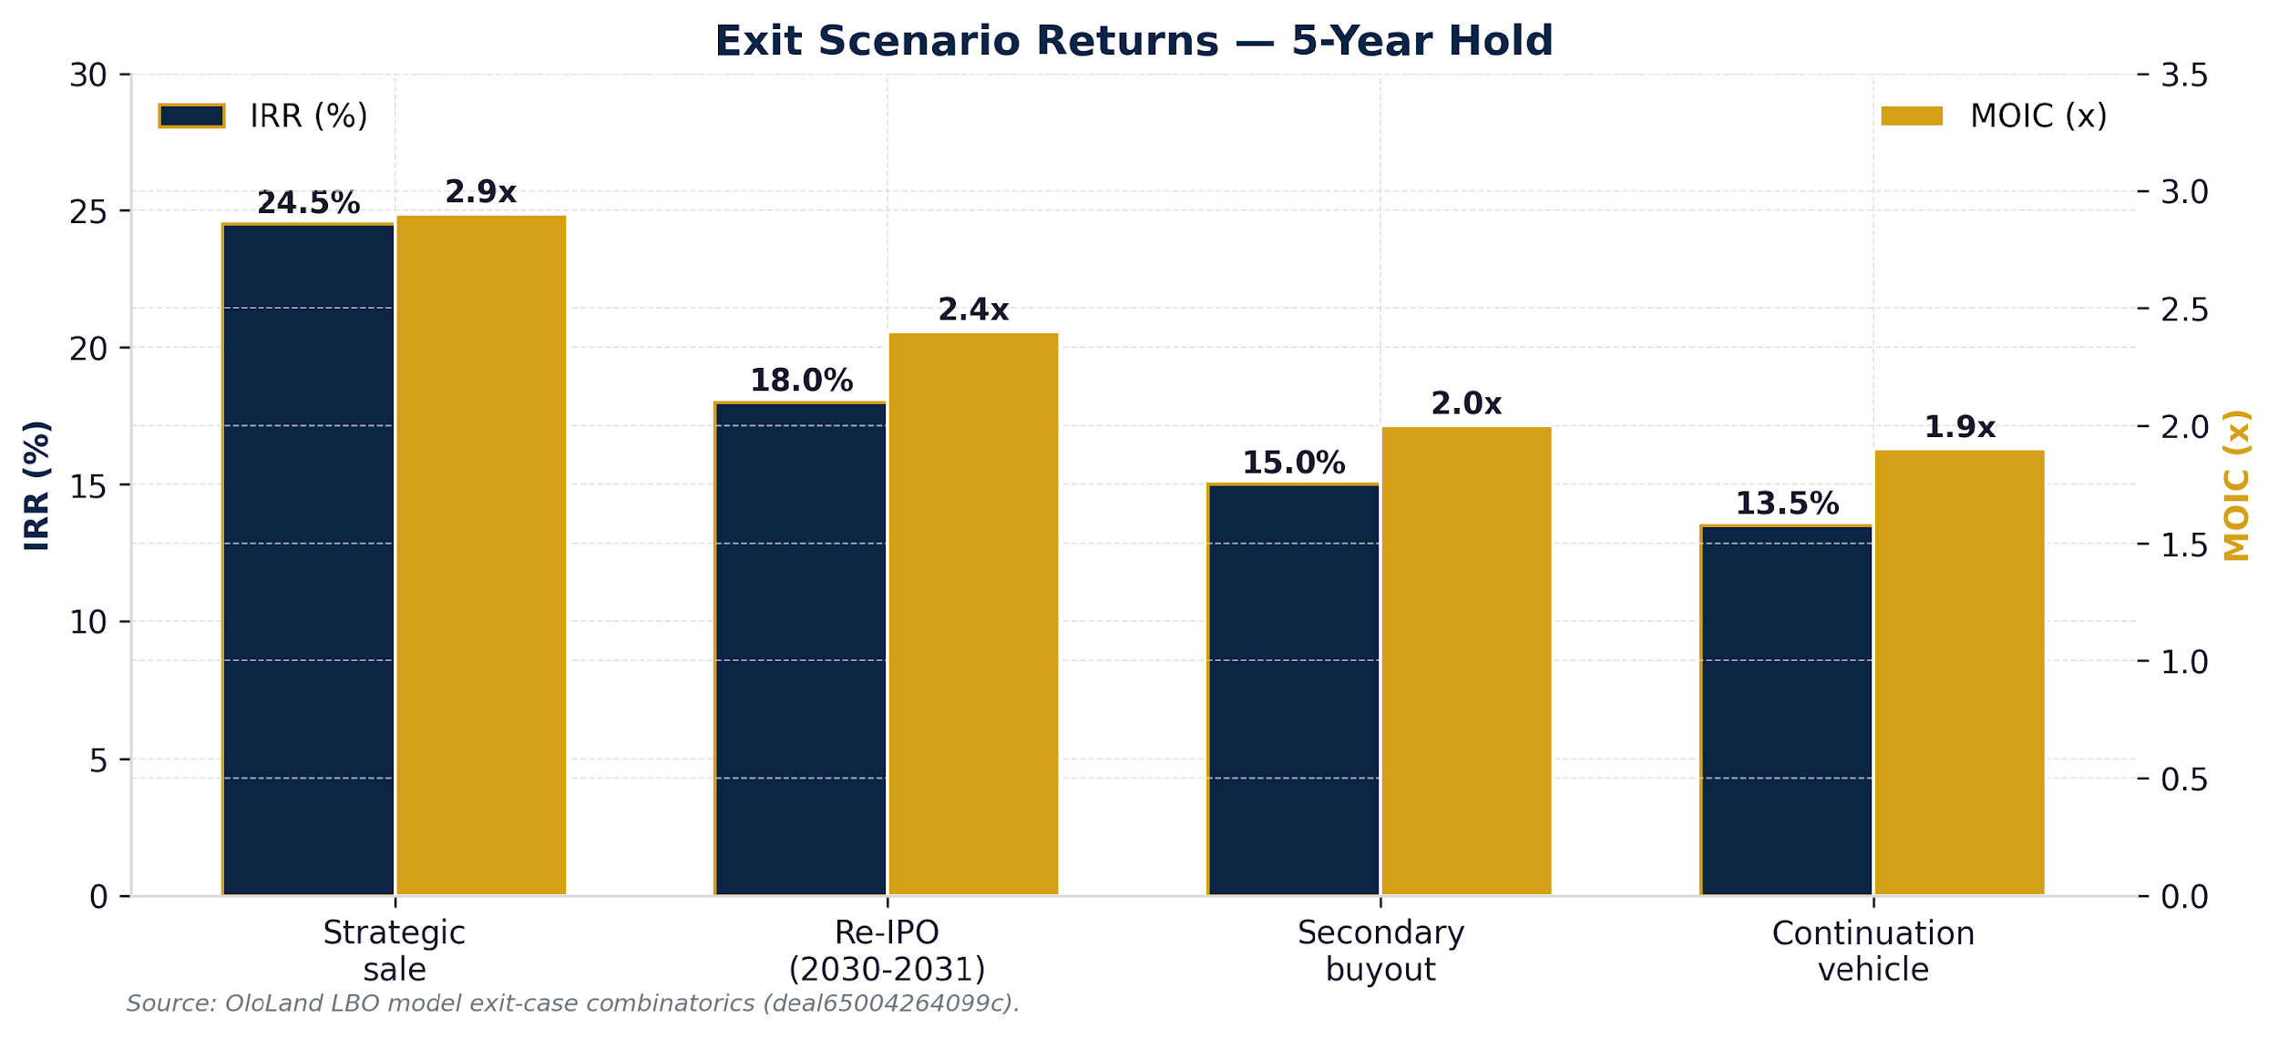
Exit Pathways
OloLand Deal Intel • v7
Five-year hold; four primary paths
Path commentary
Strategic sale (24.5% IRR)
• Best expected returns
• Targets: BKNG, TCOM, SAP
• Bolt-on logic; deepest pools
Re-IPO (18.0% IRR)
• Viable if TMC re-rates
• 2030-2031 window
• Multiple compression risk
Secondary buyout (15.0% IRR)
• Larger PE sponsors
• Capital constraints
Continuation vehicle (13.5% IRR)
• Long Lake-led
• Lower returns; reduced risk
Confidential — Long Lake / Amex GBT — Investment Committee Materials
21 of 25 • May 13, 2026

Slide 22
Conditions to Close
OloLand Deal Intel • v7
What needs to be true to clear the deal
# | Condition | Required action
1 | Amex trademark license continuity | Written rep from AXP confirming license survives change of control
2 | CoC consents at top 100 customers | ≥70% of top-100 accounts representing ~60% of revenue sign CoC consents pre-close
3 | Big-4 Quality-of-Earnings (QoE) study | Confirm run-rate Adj EBITDA ≥$680M; reconcile to management projections
4 | CTO succession | Internal or external candidate identified with 100-day onboarding plan
5 | Price step-down | If conditions 1-3 not met, re-bid at $7.40-7.80/share ($4.9-5.2B EV)
6 | Pension cash-flow study | Quantify $163M unfunded pension cash impact over 5-yr hold
7 | Working capital reserve | Reserve $200M for working-capital normalization (DSO 117 → 90 days)
Confidential — Long Lake / Amex GBT — Investment Committee Materials
22 of 25 • May 13, 2026

Slide 23
Investment Committee Recommendation
OloLand Deal Intel • v7
OloLand verdict and decision matrix
Proceed Subject to Conditions — Target Re-Engagement at $4.9-5.2B EV ($7.40-7.80/share)
Risk-adjusted fair value: $4.4-5.1B • Gap to offer: $1.70B • Closeable on satisfaction of four diligence gates
Outcome | Trigger
PROCEED at $6.30B | Requires written Amex license guarantee + ≥70% CoC consents + Big-4 QoE confirms Adj EBITDA ≥$700M
CONDITIONAL PROCEED at $5.20B | If Amex license is 'commercially reasonable' (not unconditional), reduce price by ~$1.1B
RE-ENGAGE at $4.90B | If Amex license has unilateral termination right or CoC consents <50%, walk from $6.3B
WALK AWAY | If forensic QoE cannot be completed; if CTO succession fails; if NDC margin shift quantified >2pp
Memo confidence: 0.86 • 8 platform sections + 27 analyst-extended sections • Public-facts gate verified
Confidential — Long Lake / Amex GBT — Investment Committee Materials
23 of 25 • May 13, 2026

Slide 24
Open IC Questions for Long Lake
OloLand Deal Intel • v7
12 items Long Lake's IC must answer pre-funding
1. Has AXP confirmed in writing that the trademark license survives change of control?
2. What is the customer CoC consent strategy for the top 100 accounts?
3. How does Long Lake's pre-deal portfolio (~$80M revenue) prepare it to operate at $2.7B?
4. Has FY26 forward Adj EBITDA been validated by an independent QoE study?
5. Is CWT integration on plan? What residual synergy is expected through FY27?
6. Has the $163M unfunded pension liability been quantified for cash impact?
7. Have the $164M uncertain tax positions been reviewed against settlement trends?
8. What is the management equity rollover structure?
9. How does the TLB pricing react to a credit rating action?
10. What is the contingency plan if the CTO replacement disrupts the product roadmap?
11. Has IRR target been stress-tested against materialization of just one of the top risks?
12. Is there a price step-down or walk-away mechanism in the merger agreement?
Confidential — Long Lake / Amex GBT — Investment Committee Materials
24 of 25 • May 13, 2026

Slide 25
Appendix — Plugin Stack, Provenance, Caveats
OloLand Deal Intel • v7
How this memo was generated
Plugin stack invoked
Source provenance
Plugin | Version | Status
ololand-dd | v1.6.1 | Operational
ololand-compliance-hooks | v0.2.0 | Operational
ololand-forensic-qoe | v0.2.0 | Blocked (inputs)
• GBTG FY25 10-K (3/9/2026, accession 0001628280-26-015817)
• GBTG Q1 2026 10-Q (5/11/2026, accession 0001628280-26-033155)
• 8-K Long Lake Merger (5/4/2026)
• Q1 2026 Earnings Release (5/4/2026)
• BusinessWire Long Lake Acquisition press release
• Navan S-1 (TAM=$185B, 2024)
• Industry analyst consensus (TMC market $23.4B → $48B, 16.2% CAGR)
• Public comps from 10-K filings + market data
Engine calls (key)
• create_deal → deal65004264099c
• run_due_diligence → 375 risks (2H/180M/193L)
• compose_ic_memo (web_facts_required=True) → 168s, 1534 words, 0.86 confidence
• run_monte_carlo_simulation (10k paths) → EV mean $1.24B GAAP, overridden to Adj basis
• talk_to_deal (analyst voice) → FAIL verdict in 31.6s
• fetch_public_deal_facts → 5/4 announcement verified
Caveats
• Forensic QoE blocked: no GL transactions extractable
• Assumption ledger empty: backend writeback gap
• IC package not linked (snapshot not created)
• Sponsor not committed to walk; this memo is OloLand opinion
• Generated by OloLand AI; not legal or financial advice
v7 update — post full-analysis engine reconciliation
OloLand DCF: $4.34B EV (WACC 11.2%, g 2.5%, margin 20% flat). LBO scenarios: bear 16.5% / base 22.9% / bull 29.5% IRR. Risk-to-Model Diff: WACC +2.0 pp, bid reduction $130.8M. Hidden Downside (operating): P50 $33.6M / P75 $42.0M / P90 $52.5M.
Engine caveats logged: shares-outstanding field returns 1.0B (vs ~488.9M actual — DCF per-share impacted); risk_adjusted_enterprise_value tile returns $0 (engine bug); assumption ledger writeback not yet wired (gate vacuous); IC package not auto-linked to memo; forensic-QoE completed but data-limited (0 GL transactions extracted). All material findings reflected in this deck use the engine outputs that did populate correctly.
Confidential — Long Lake / Amex GBT — Investment Committee Materials
25 of 25 • May 13, 2026

